Slide 1

Association mining
Sofia Denisenko 狄苏菲 1820249051

Slide 2
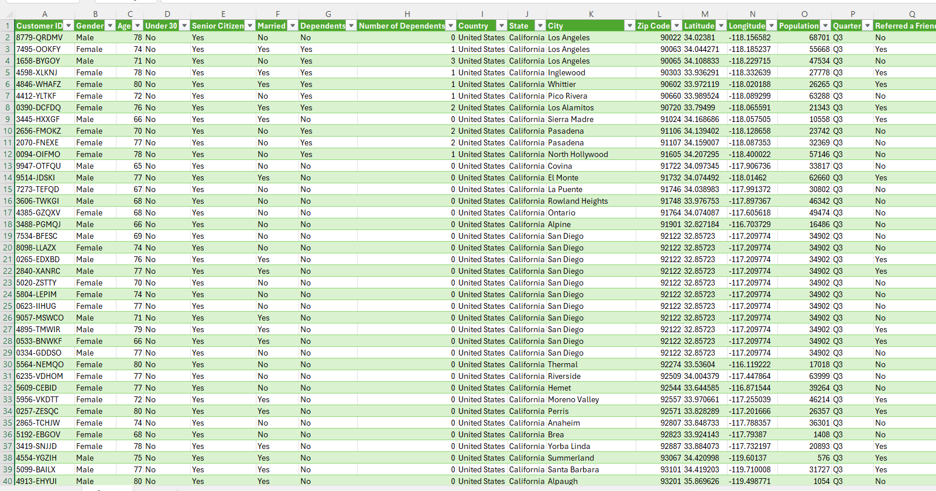
TELCO Dataset (cleaned in previous assignment)

Slide 3
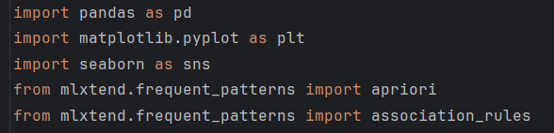
Libraries
Pandas (for data manipulation and analysis)
Matplotlib (for creating charts and graphs)
Seaborn (for statistical visualization)
mlxtend (for association rule mining algorithms)

Slide 4
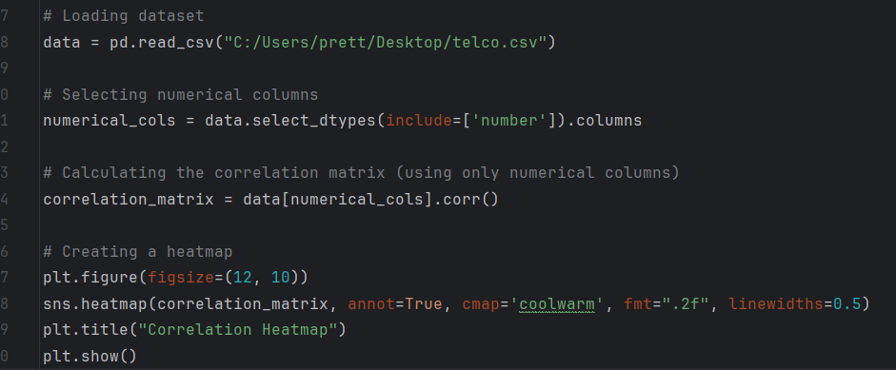
Loading dataset and creating a heatmap using numerical columns

Slide 5
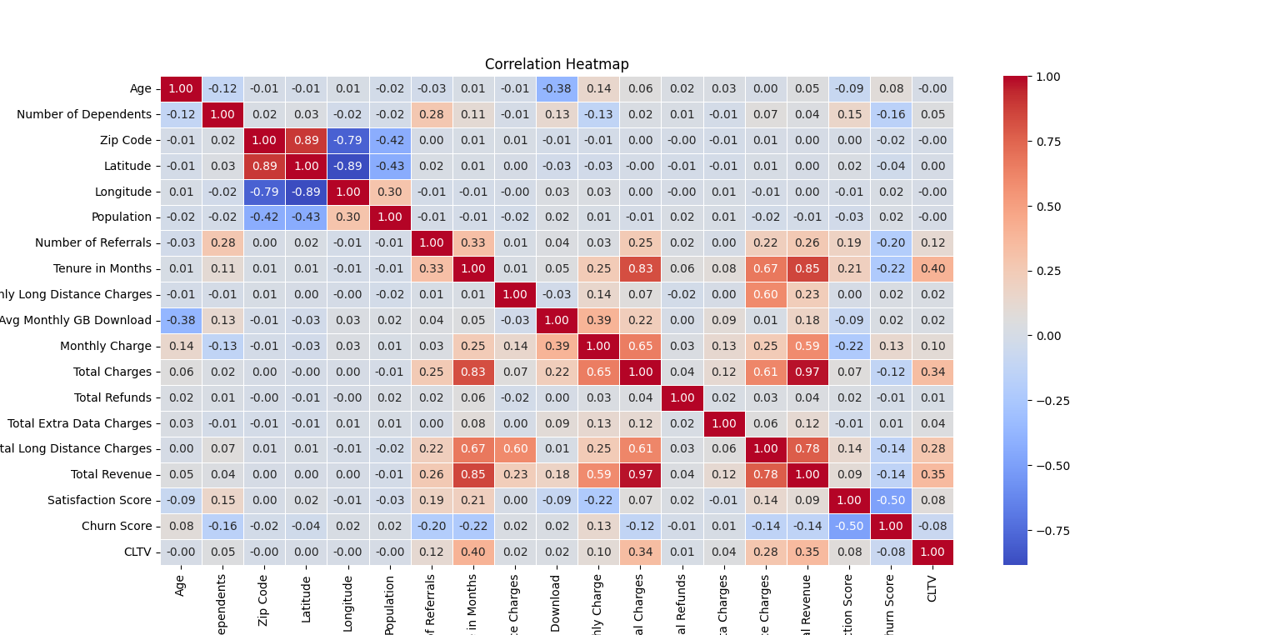
Result

Slide 6
Overview
Strong Positive Correlations:
Zip Code and Latitude/Longitude
Number of Referrals and Tenure in Months
Monthly Charges and Total Charges
Total Charges and Total Revenue
Monthly Charges and Total Extra Data Charges
Monthly Charges and Total Revenue
Strong Negative Correlations:
Zip Code and Population
Latitude and Longitude
Monthly Long Distance Charges and Average Monthly GB Download

Slide 7
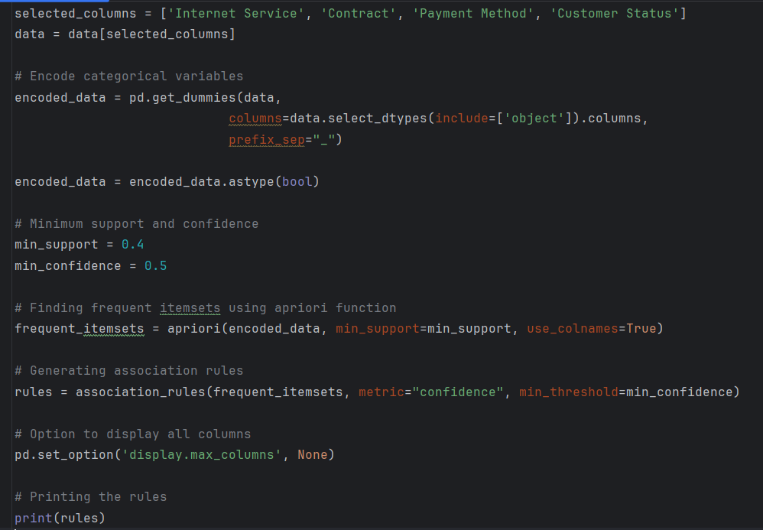
Finding the associations using apriori function

Slide 8
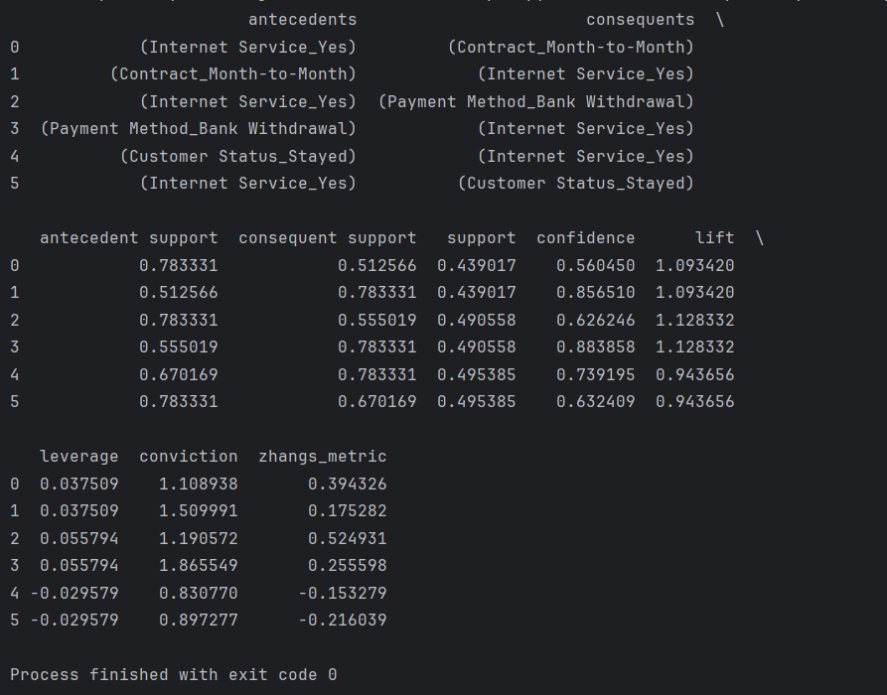
Results

Slide 9
Overview
For the task I chosed 4 columns 'Internet Service', 'Contract', 'Payment Method', 'Customer Status’ and got 6 rules.
Rule 0&1:
antecedents: (Internet Service_Yes)
consequents: (Payment Method_Bank Withdrawal)
confidence: 0.626246 and 0.883858
lift: 1.128332 (the same for both)
Customers with any type of internet service are slightly more likely to use Bank Withdrawal as
their payment method. The lift is slightly above 1, indicating a very weak positive association.
Rule 2&3:
antecedents: (Internet Service_Yes)
consequents: (Contract_Month-to-Month)
confidence: 0.560450 and 0.856510
lift: 1.093420 (the same for both)
Customers with any type of internet service are slightly more likely to have a Month-to-Month
contract. The lift is slightly above 1, indicating a very weak positive association.
Rule 4&5:
antecedents: (Internet Service_Yes)
consequents: (Customer Status_Stayed)
confidence: 0.632409 and 0.739195
lift: 0.943656 (the same for both)
This rule shows a negative association, as the lift is less than 1. Customers with any type of
internet service are less likely to have stayed with the service compared to customers without
internet.

Slide 10

Potential application
The results can help the company identify customer segments based on their preferences for internet service, contract type, payment method, and churn likelihood.
Also, company can customize communication based on individual customer profiles.

